Slide 1

Breast Cancer Detection and Development of its Recurrence Prediction Model Using Machine Learning Techniques
DEPARTMENT OF COMPUTER SCIENCE AND ENGINEERING
BIRLA INSTITUTE OF TECHNOLOGY MESRA, PATNA CAMPUS
Presented by:- ANJALI KISHEN (BE/15189/16) and
TRIPNA MEHTA (BE/15279/16)
Submitted to:- Prof. SHEEL SHALINI , Department of Cse/it, birla Institute of Technology Mesra, Patna campus.

Slide 2

Introduction: what is machine learning AND WHY WE ARE USING IT ?
Machine learning (ML) is the subfield of Computer Science that gives the computer “ability to learn without being explicitly programmed.” Machine learning allows developers to build algorithms that automatically improve themselves by finding patterns in the existing data without explicit instructions from a human or developer.

Slide 3
Breast cancer: an overview
• Breast cancer is the second leading cause of cancer death in women, second only to lung cancer.
• The leading risk factor for breast cancer is simply being a woman. Though breast cancer does occur in men, the disease is 100 times more common in women.
• In 2017, the American Cancer Society estimates 2,470 new cases of breast cancer which was diagnosed in men in the U.S.
• A woman has about a one in eight chance of being diagnosed with breast cancer in her lifetime, according to the national cancer institute.
• Most women (about eight out of 10) who get breast cancer do not have a family history of the disease.
• But women who have close blood relatives with breast cancer have a higher risk. Having a first-degree relative (mother, sister or daughter) with breast cancer almost doubles a woman’s risk.

Slide 4
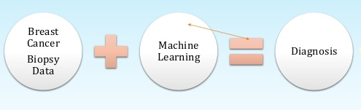
Why are we using machine learning?

Slide 5
Machine learning algorithms
Classification and Regression Trees (CART)
Linear Support Vector Machines (SVM)
Gaussian Naive Bayes (NB)
k-Nearest Neighbors (KNN)

Slide 6
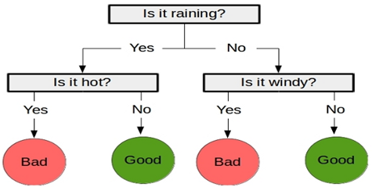
Classification and Regression Trees (CART)

Slide 7
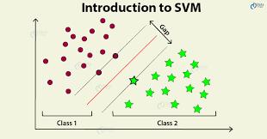
Linear Support Vector Machines (SVM)

Slide 8
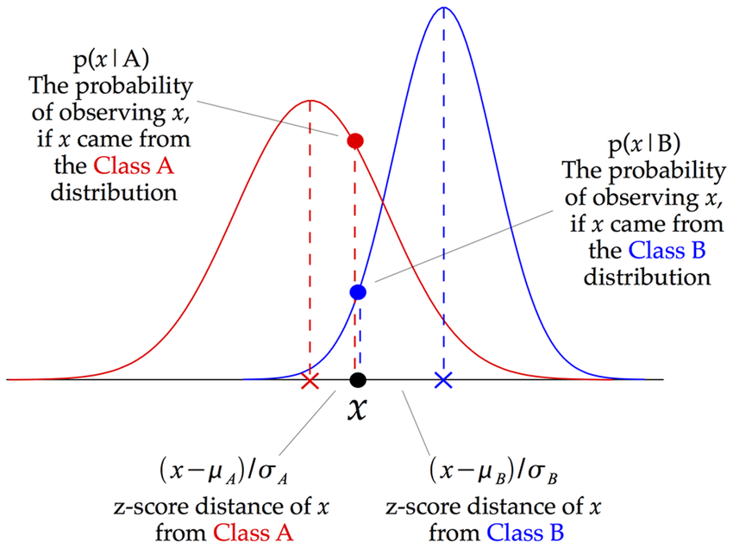
Gaussian Naive Bayes (NB)

Slide 9
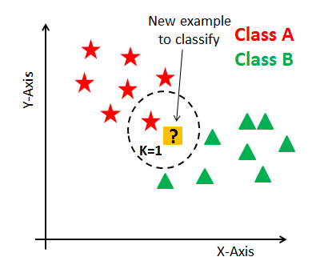
k-Nearest Neighbors (KNN)

Slide 10
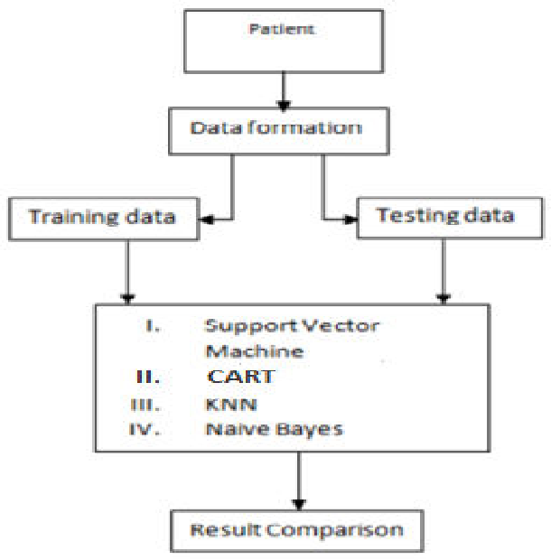
Flow chart

Slide 11
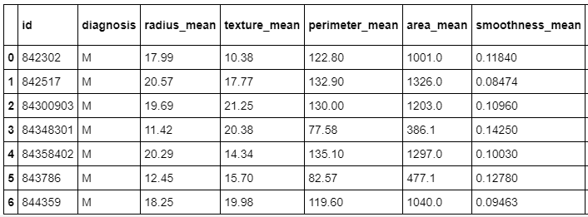
Snapshot of Data used in analysis

Slide 12
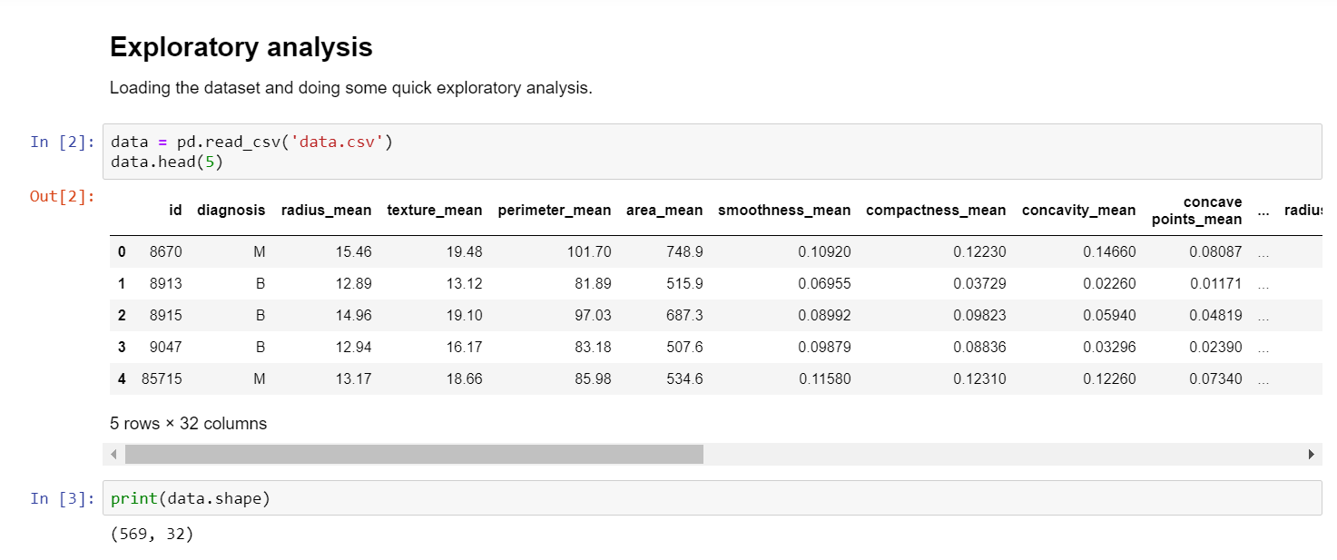
1. Collecting of dataset
We will utilize the Wisconsin Breast Cancer Diagnostic Dataset from the UCI machine learning repository at http://archive.Ics.Uci.Edu/ml. This data was donated by researchers of the University Of Wisconsin. The breast cancer data includes 569 examples of cancer biopsies, each with 32 features.

Slide 13
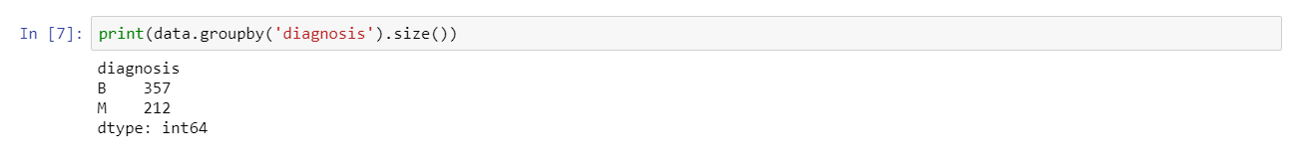
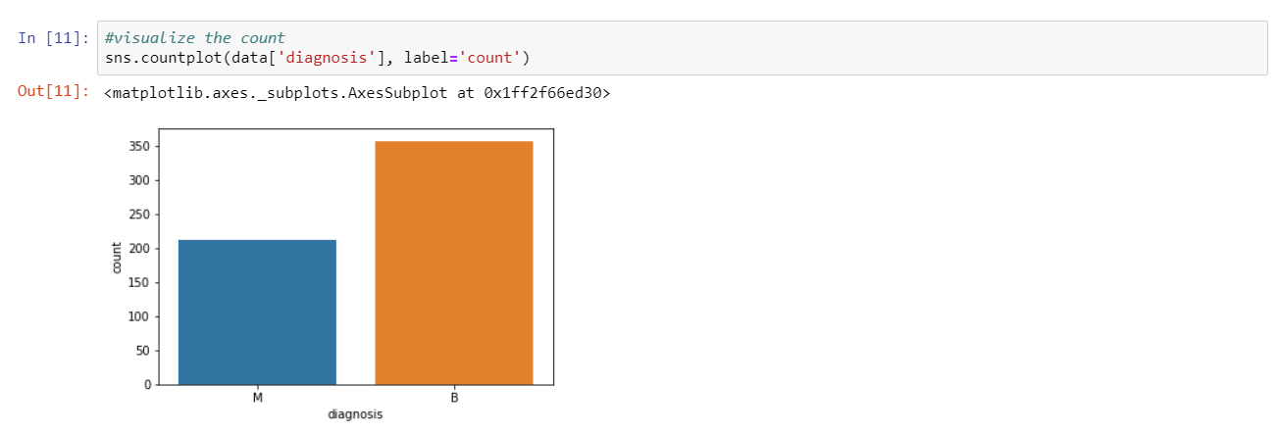
2. Exploring and preparing data
Importing the data set in Jupyter notebook using python language .
The table( ) output indicates that 357 masses are benign while 212 are malignant

Slide 14
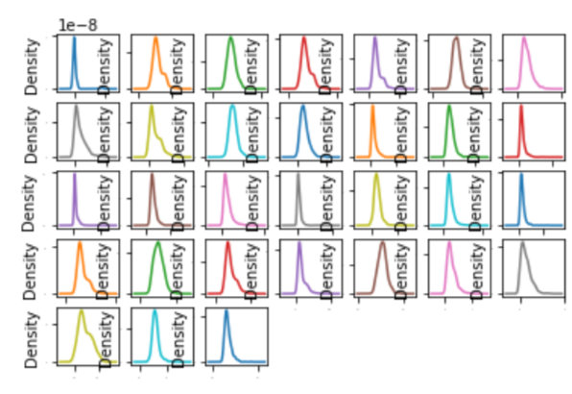
Visualization 1 We can visualize the data using density plots to get a sense of the data distribution. From the outputs below, you can see the data shows a general Gaussian Distribution.

Slide 15
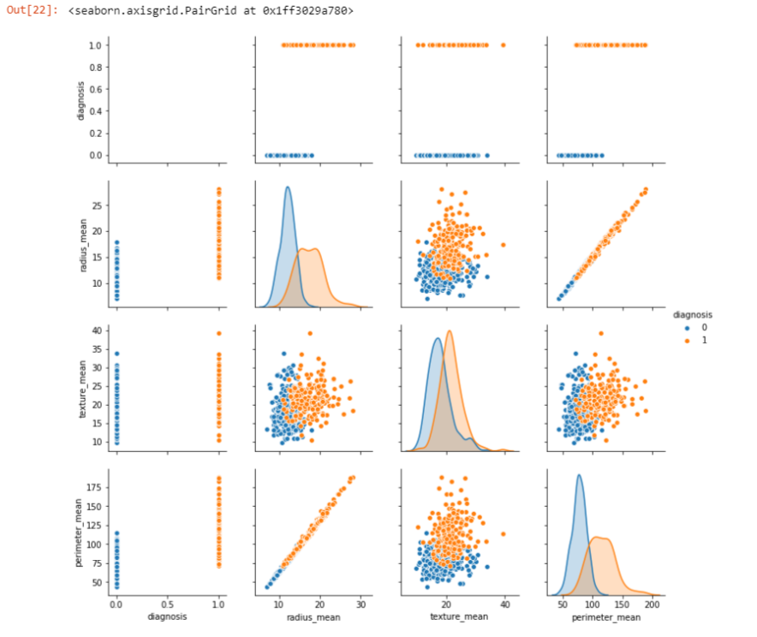
Visualization 2

Slide 16
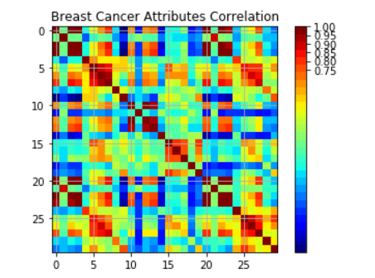
VISUALIZATION 3
Correlation Graph
From the output graph below, the red patches around the diagonal suggests that attributes are in positive correlation with each other. The yellow and green patches suggest some moderate correlation and the blue boxes show negative correlations.

Slide 17
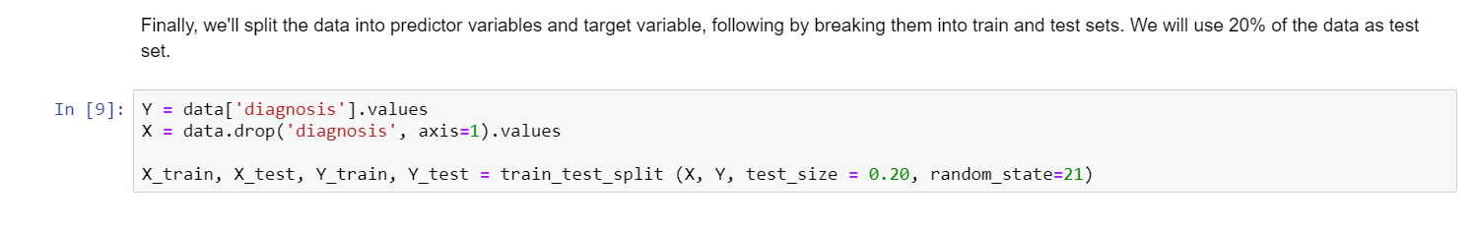
3. creating training and test datasets
Finally, we'll split the data into predictor variables and target variable, following by breaking them into train and test sets. We will use 30% of the data as test set.

Slide 18
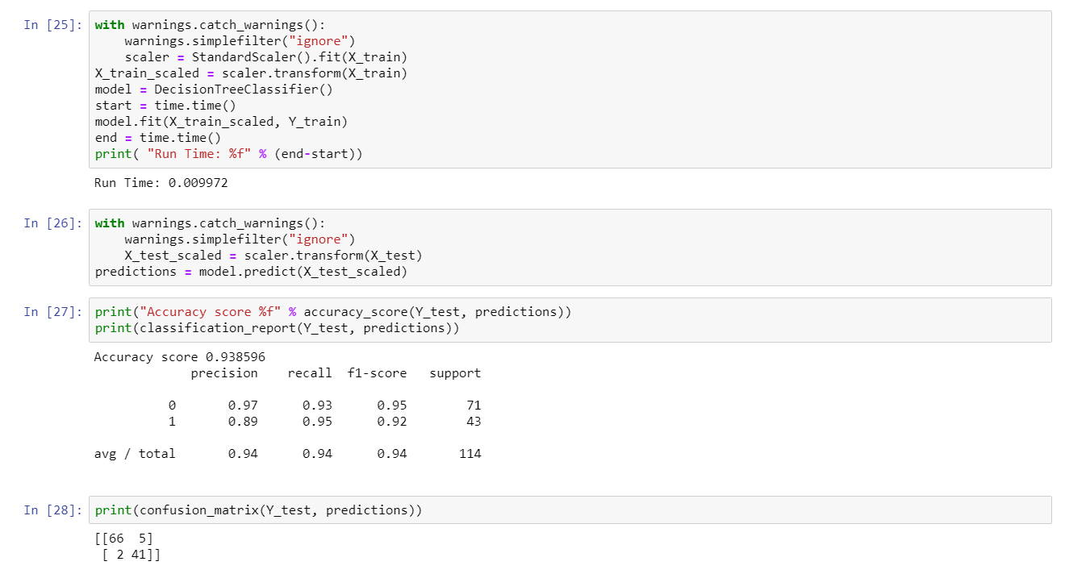
Accuracy Analysis of Algorithms 1. confusion matrix: DT Algorithm

Slide 19
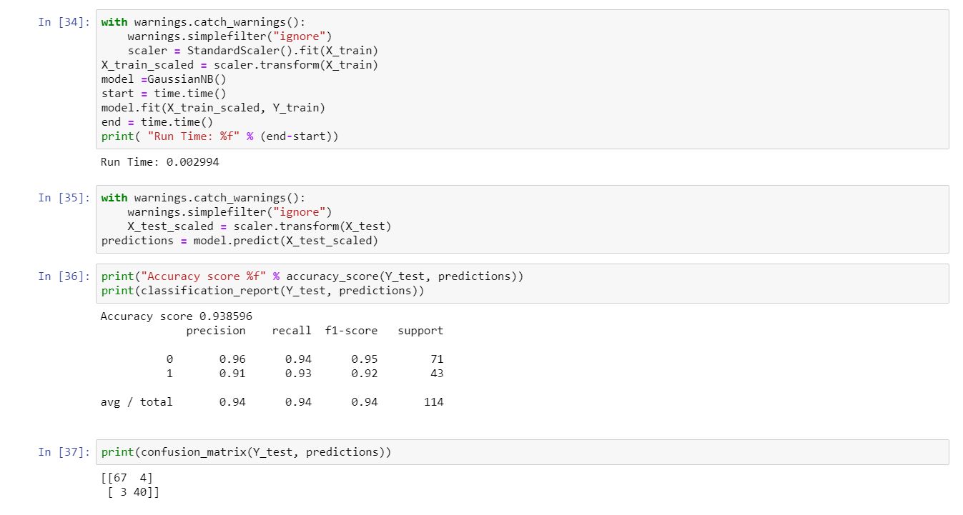
2. confusion matrix: NB Algorithm

Slide 20
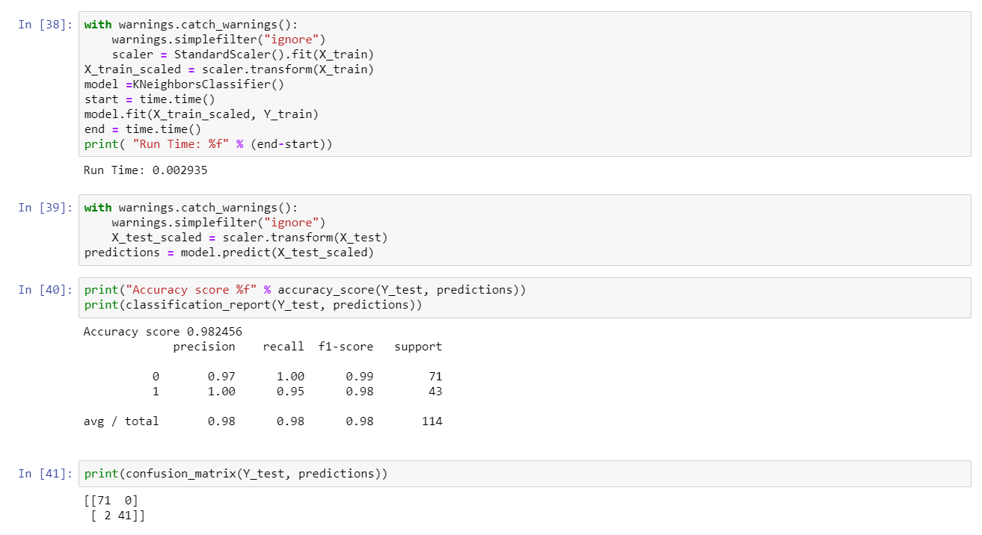
3. confusion matrix: KNN Algorithm

Slide 21
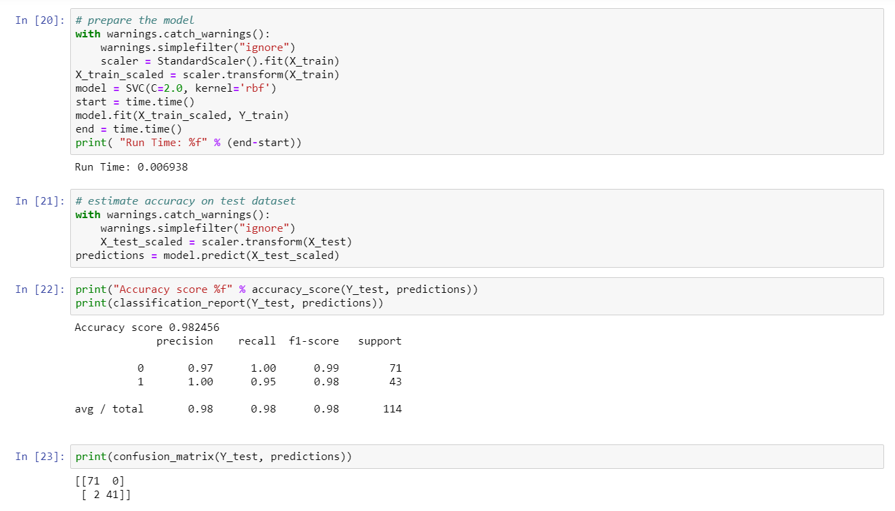
4. confusion matrix: SVM Algorithm

Slide 22
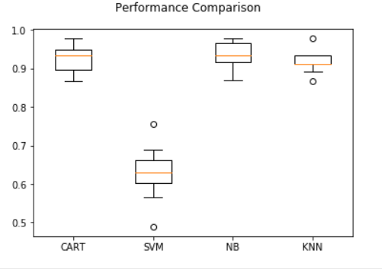
The performance comparison of the all four machine learning algorithms on non-scaled data:
FOLLOWING GRAPH Shows THAT :
the performance accuracy of CART IS 92%
the performance accuracy of SVM IS 62.9%.
performance accuracy of NB IS 93.6%.
the performance accuracy of KNN IS 91.8%.

Slide 23
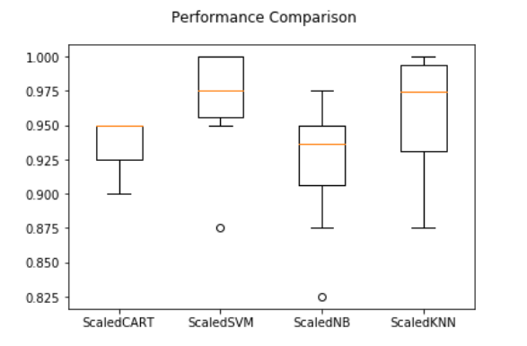
The performance comparison of the all four machine learning algorithms on standardised data:
The FOLLOWING analysis shows that accuracy of CART, NB, KNN and SVM are 0.95, 0.931, 0.964 and 0.971 respectively.

Slide 24
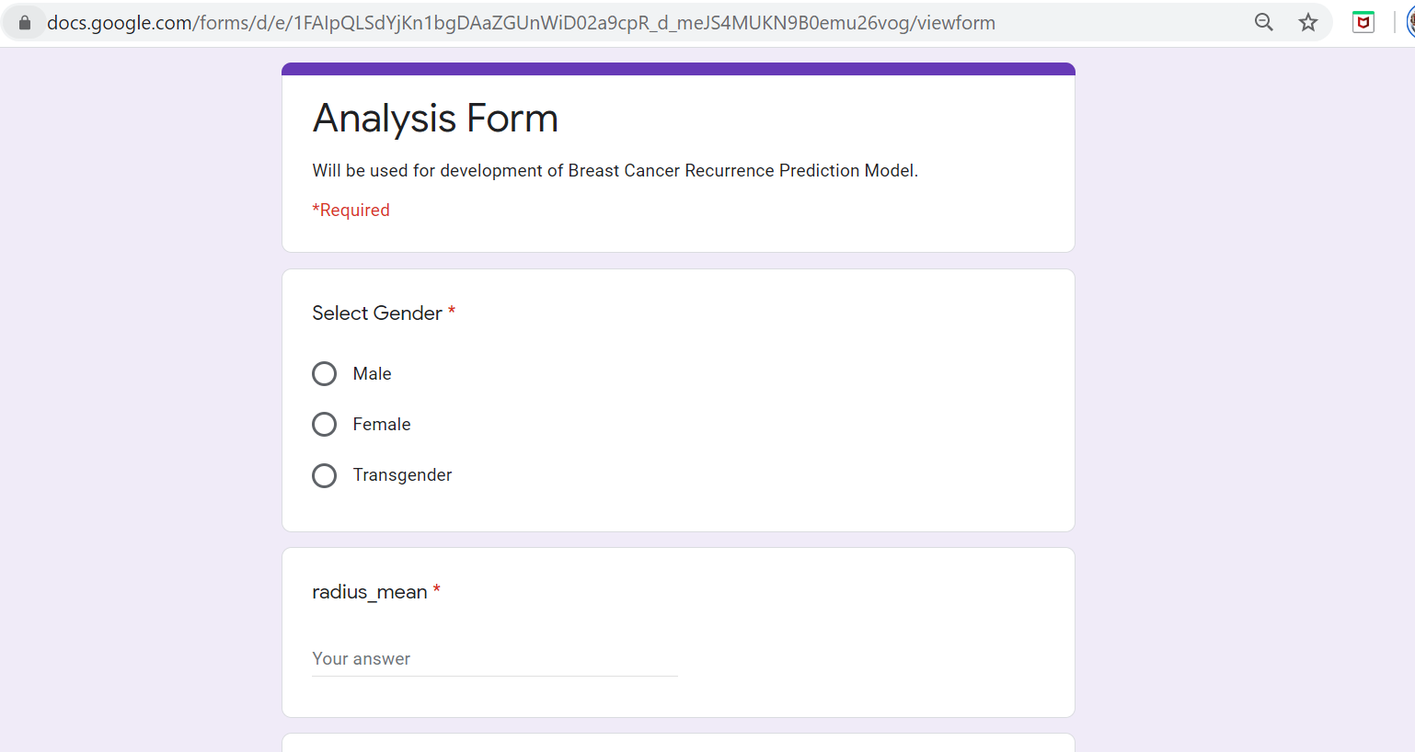
Survey for Development for Recurrence Prediction Model
Since we have no verified data for breast cancer recurrence prediction (based on the patient's medical inventory), we have conducted a survey.
https://docs.google.com/forms/d/e/1FAIpQLSdYjKn1bgDAaZGUnWiD02a9cpR_d_meJS4MUKN9B0emu26vog/viewform?usp=sf_link
LINK FOR THE SURVEY

Slide 25
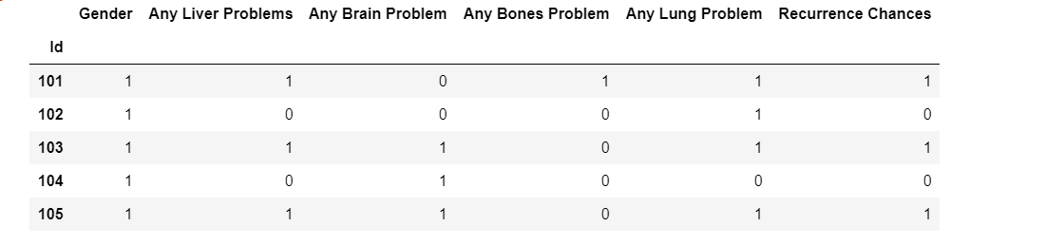
Data Retrieved FROM SURVEY -

Slide 26
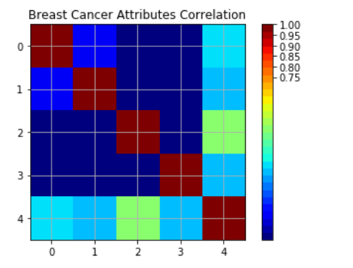
correlation matrix heatmap for the data set Correlation measures the strength of the linear relationship between two variables. The closer the value is to 1 the closer the data points fall to a straight line. Thus, the linear association is stronger. The closer the value is to 0, making the linear association weaker.

Slide 27
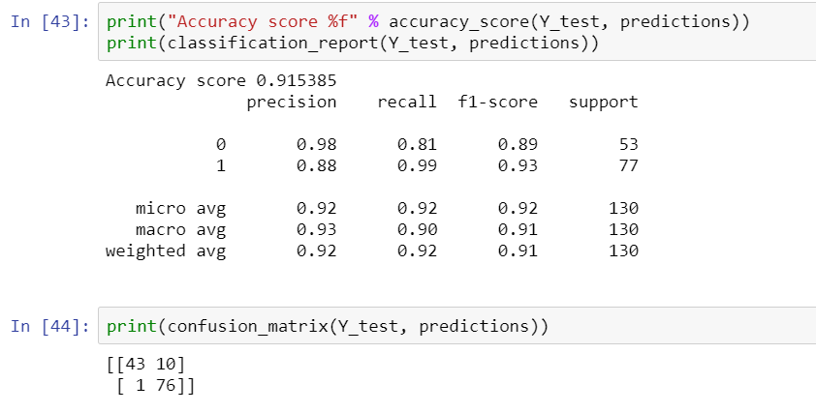
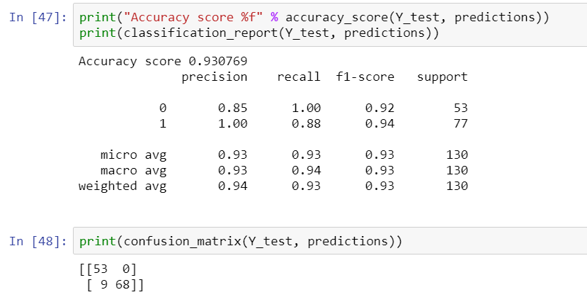
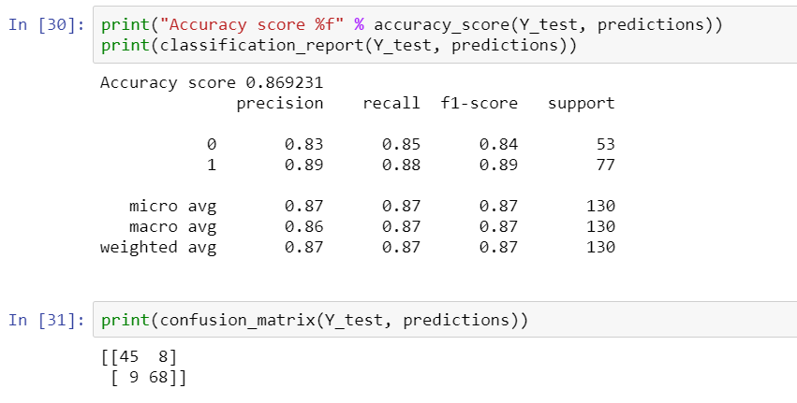
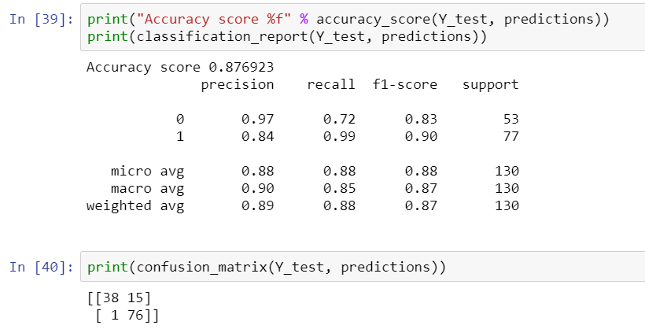
confusion matrix OF ALL ALGORITHMS
CART
NB
KNN
SVM

Slide 28
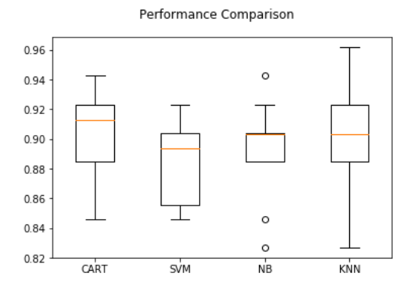
The performance comparison of the all four machine learning algorithms on Survey data:
FOLLOWING GRAPH SHOWS THAT :
The performance accuracy of CART IS 91%
The performance accuracy of SVM IS 88.9%.
The performance accuracy of NB IS 90%.
The performance accuracy of KNN IS 90.8%.

Slide 29
Conclusion
As an overall conclusion based on the results obtained, we would say:
Using the Wisconsin Breast Cancer Diagnostic Dataset from the UCI machine learning repository for the prediction of breast cancer prediction and diagnosis, we found that SVM is the best among all other algorithms with 97.1% accuracy.
Using the survey dataset for the breast cancer recurrence prediction, the CART algorithm predicts breast cancer recurrence with least error rate and highest accuracy about 91%.Hence CART algorithm is best for recurrence model.

Slide 30


